Slide 1
Mini-Project -II Presentation
On
The-Grocers-Market
GLA University
Mathura-281406 , India
Under The Supervision of :
Ms. Ruchi Gupta
(Senior Trainer)
Department of CEA
GLA University, Mathura (U.P.)
Submitted By :
Krishna Gupta (181500330)
Mukul Agrawal (181500397)
Ankit (181500096)
Nitin Kumar (181500433)

Slide 2
Content
Introduction
Objectives and Purpose
Project Scope
Tools and Technology
Data Flow Diagram
ER-Diagram
Screenshots
Conclusion and Future Work

Slide 3
Introduction
A website to connect shopkeepers online.
A website that will allow you to buy from your favourite store near you online.
A way of digitization for the sellers and customers.
Just create an account and take your shop online.
Wide range of variety for customer.
No need to go to shop.

Slide 4
Objectives and Purpose
Reduction of expiry items.
Increase in sale by the observation of sale of products by the customers
Coming back to track which they were kicked off by malls and big shops connected online.
Promoting digitalization scheme and competing other shopkeepers.
Providing services at doorstep.

Slide 5
Project Scope
Simple
Fast
Time Saving
Inexpensive

Slide 6
Tools and Technology:
Technologies
HTML
CSS
PHP
JavaScript
MySql
Tools
VSCode
Xampp Server

Slide 7
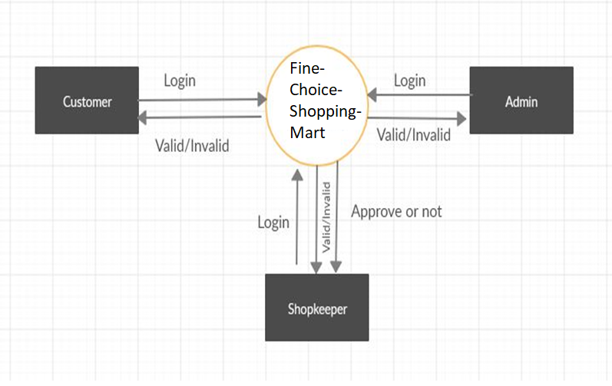
Data Flow Diagram
Level 0

Slide 8
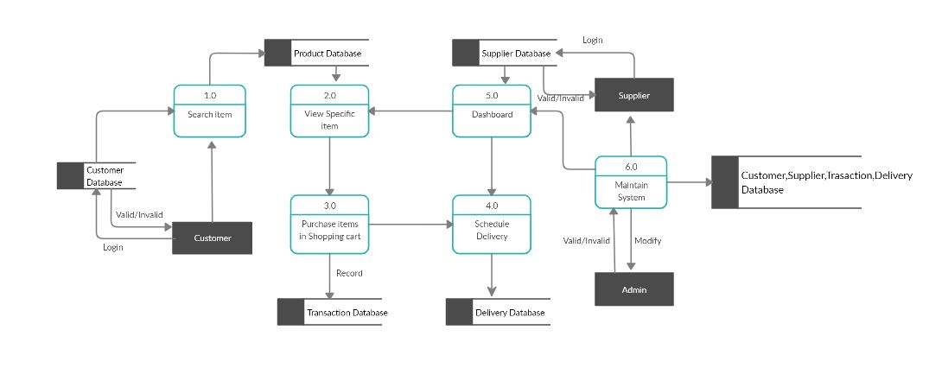
Level 1

Slide 9
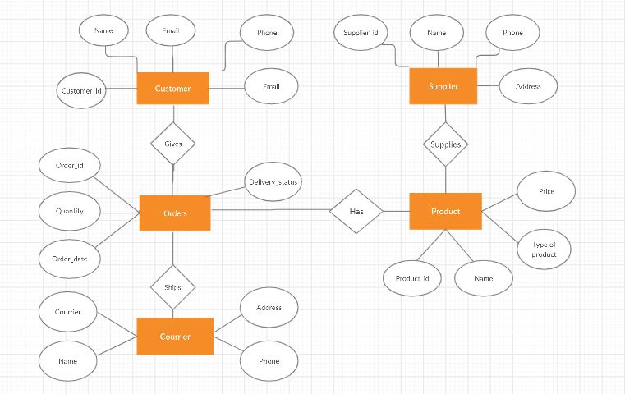
ER-Diagram

Slide 10
SNAPSHOTS

Slide 11
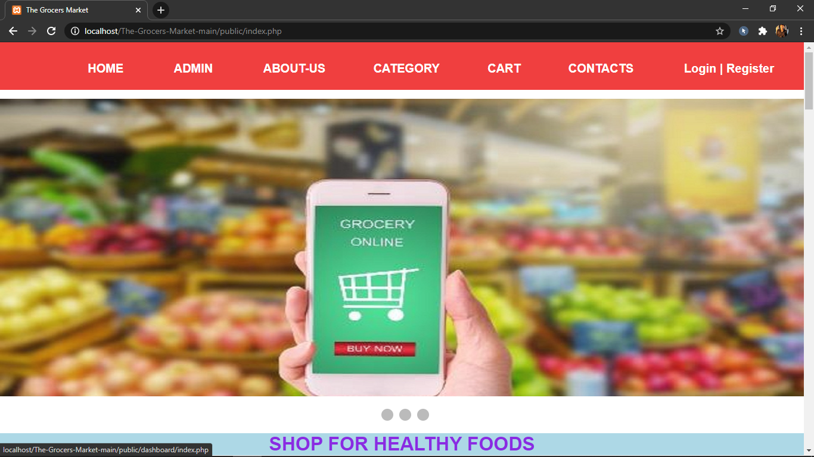

Slide 12
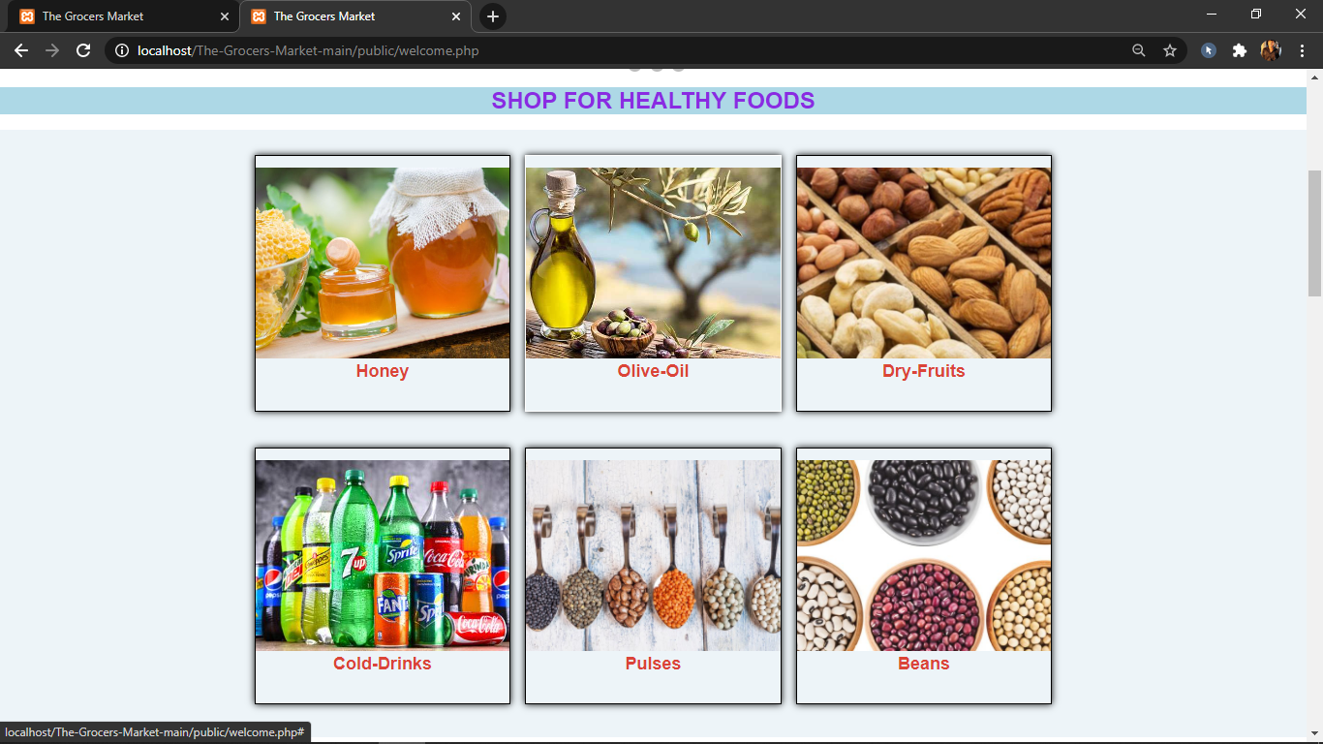

Slide 13
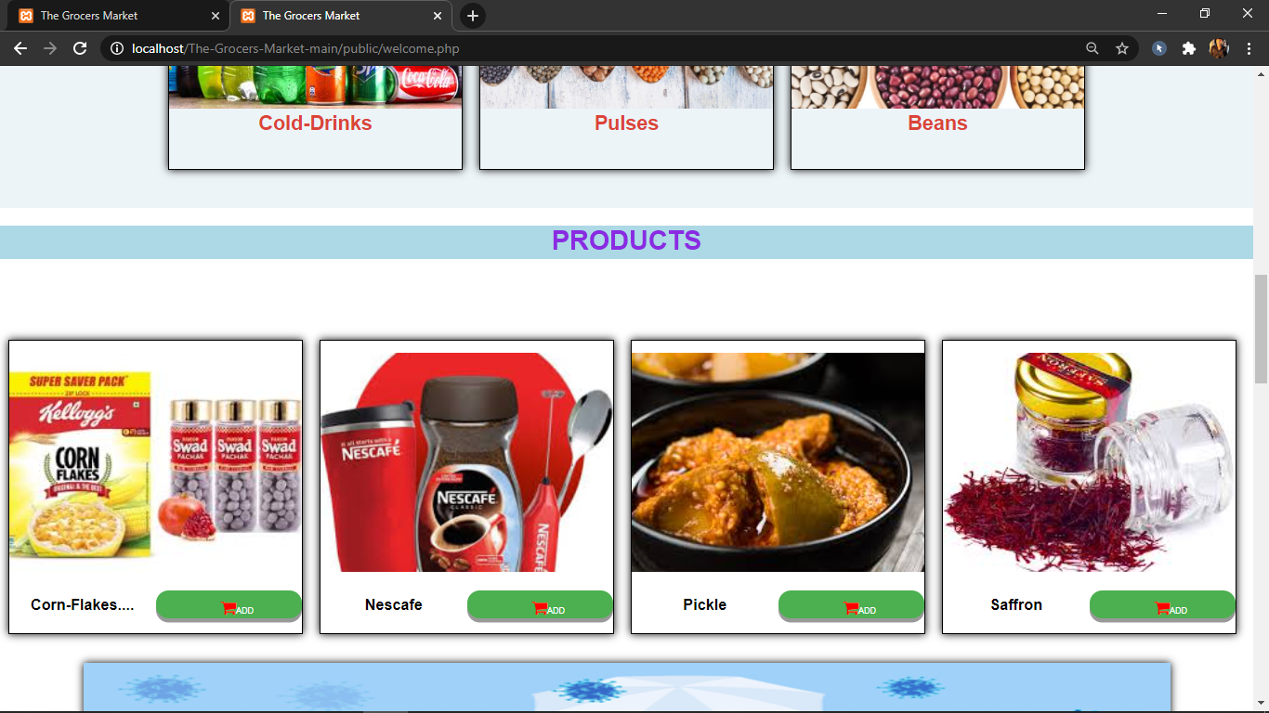

Slide 14
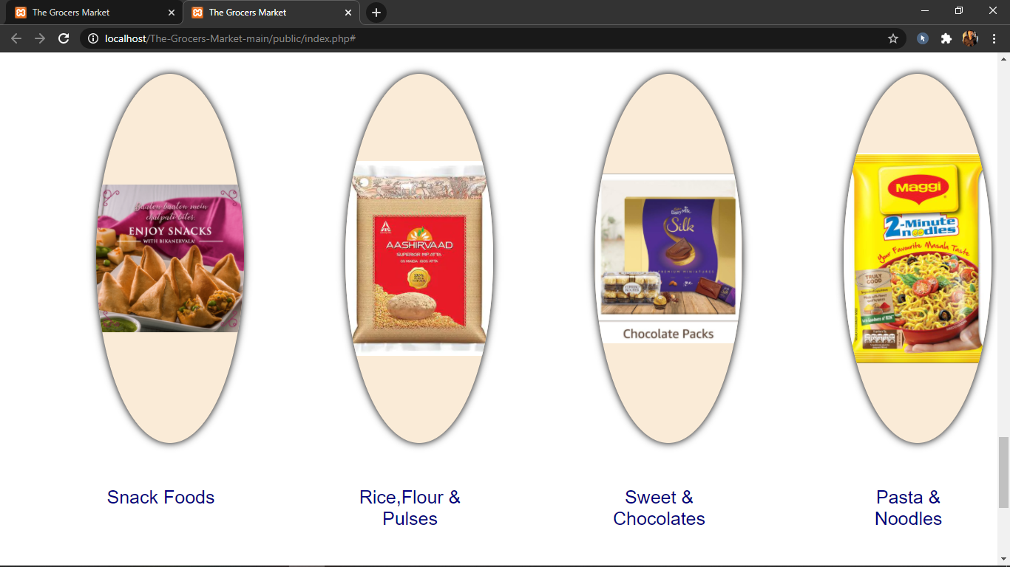

Slide 15
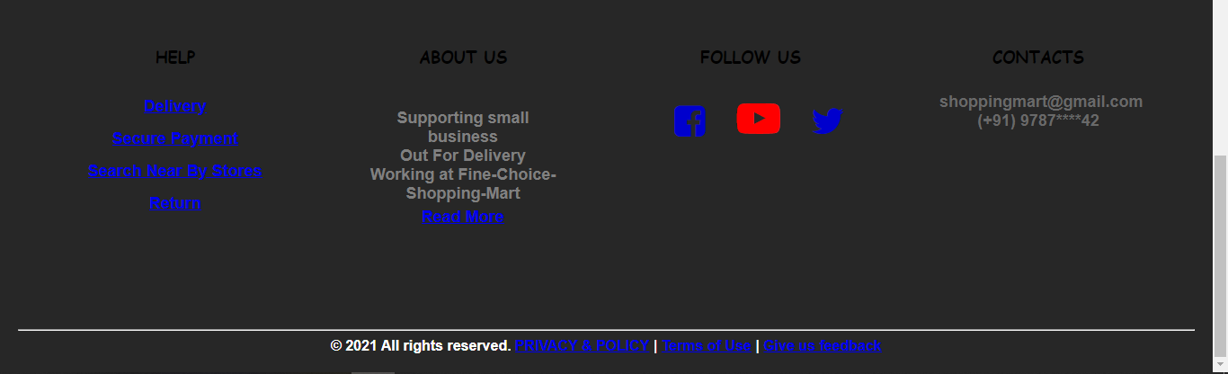

Slide 16
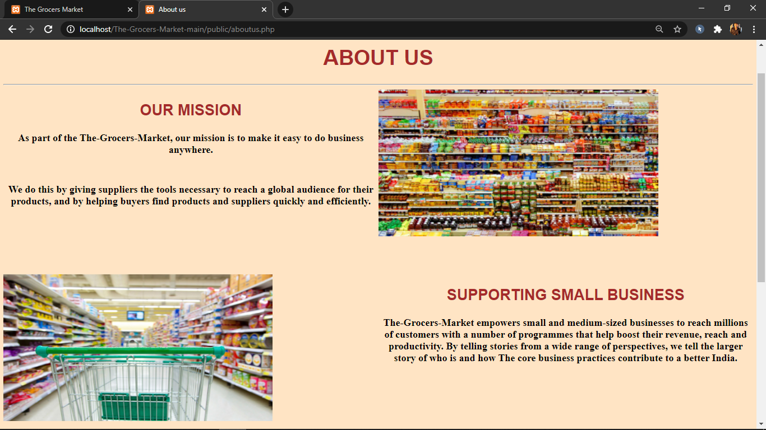

Slide 17
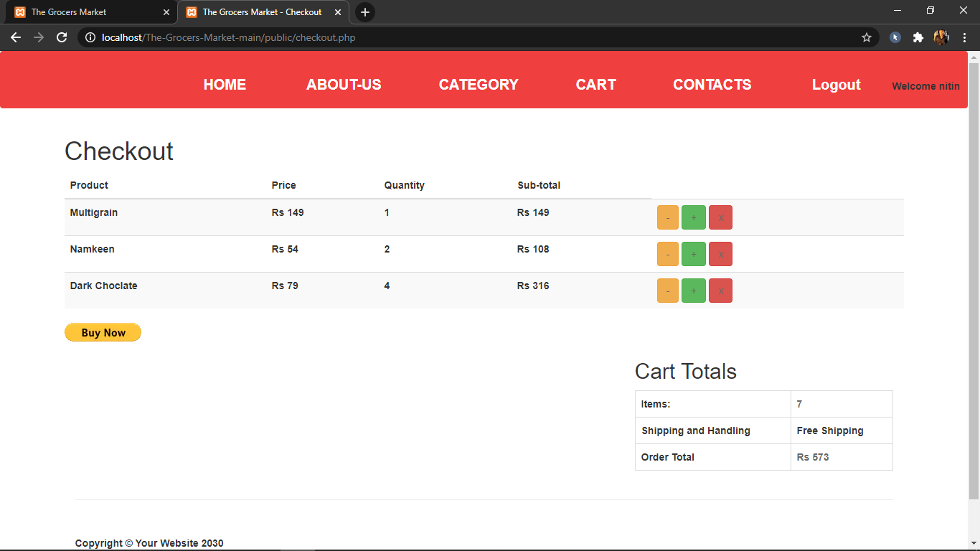

Slide 18
Conclusion and Future Work
This Project is useful for those who wants to grow their business on online.
The businessman can easily manage their business using this project.
We can make this website more attractive using bootstrap.
We can expand this website using adding different variety of products.

Slide 19
Thank You

